Slide 1
Week 1: Introduction to
Health Economics
HPM 6503
Spring 2026
Nada Boualam, PhD

Slide 2
Week 1: Outline
Teaching team introductions
Course overview
Course policies
Break
Today’s material
  I - What is health economics?
  II - Why health economics?
  III - Opportunity cost & scarcity
  IV - Thinking on the margin
  V - Rational thinking

Slide 3
Teaching Team Introductions
Instructor: Nada Boualam, PhD
Adjunct Professor, Columbia Mailman SPH
Full time work at Flatiron Health as an Associate Research Scientist
PhD in Health Economics (pharmaceutical policy focus)
Talk to me about: pharma/biotech, causal inference in industry work, HEOR
TAs: Julia, Salome (Sally), Devon
If your last name starts with A-H, your lead TA is Julia
If your last name starts with I-P, your lead TA is Salome (Sally)
If your last name starts with R-Z, your lead TA is Devon

Slide 4
Course Overview
At the end of the course, you should be able to use economic theory and analysis to identify, understand, assess, anticipate and respond to developments in the healthcare marketplace.
→ Learn to think about health using a microeconomic framework.

Slide 5



Do not edit
How to change the design
What classes have you taken?
Presenting with animations, GIFs or speaker notes? Enable our Chrome extension
Notes:
📣 This is Slido interaction slide, please don't delete it.
✅ Click on 'Present with Slido' and the poll will launch automatically when you get to this slide.

Slide 6
Course Policies
Readings: posted in modules ~1 week prior to class
Slides: uploaded after class
Problem Sets: there will be 5 problem sets throughout the semester to help you master the material. Your top 4 grades will be averaged, worth 5% each
Exams: there will be 2 midterms and a final exam, worth 25% each
Attendance: Participate in class, & check in using the quizzes on the slides, 5%

Slide 7
Course Policies
Course evaluations: Please use course evaluations to help us improve the course, & come to use with any questions / comments / concerns throughout the semester
Review Sessions: there will be at least one TA-led review session prior to each exam
Late Assignments: Problem Sets will be assigned after class and due at 5pm the following Wednesday. No problem set will be accepted after 5pm.
Office hours: Before or after class, or by appointment on Zoom

Slide 8
Do not edit
How to change the design
Which office hours work best for you? Choose one per TA.
Presenting with animations, GIFs or speaker notes? Enable our Chrome extension
Notes:
📣 This is Slido interaction slide, please don't delete it.
✅ Click on 'Present with Slido' and the poll will launch automatically when you get to this slide.

Slide 9
Break

Slide 10
Material for today’s class
I - What is health economics?
II - Why health economics?
III - Opportunity cost & scarcity
IV - Thinking on the margin
V - Rational thinking

Slide 11
What is health economics?
[Economics]
Economics is the study of scarcity, of how people use resources and respond to incentives, and of decision-making. [AEA]
Broad discipline that helps us understand historical trends, interpret today’s headlines, and make predictions about the coming years.
Branches of economics:
Microeconomics focuses on individual stakeholders (individuals, firms)
Macroeconomics focuses on the economy as a whole
Econometrics focuses on the statistical toolkit needed to study economics questions.
Notes:
It often involves topics like wealth and finance, but it’s not all about money.
Economics ranges from the very small to the very large. The study of individual decisions is called microeconomics. The study of the economy as a whole is called macroeconomics. A microeconomist might focus on families’ medical debt, whereas a macroeconomist might focus on sovereign debt.

Slide 12
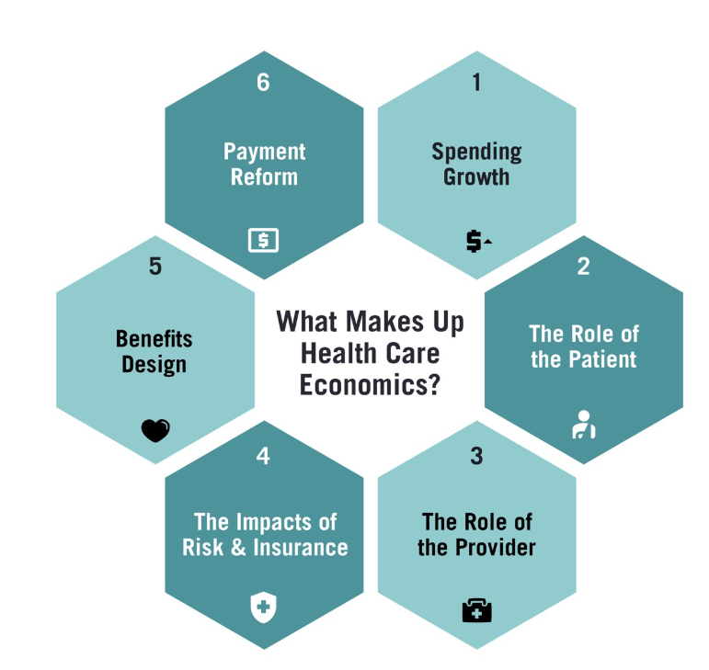
What is health economics?
[Health Economics]
Application of economic theory and methods to health and healthcare questions. HE seeks to understand the role that individuals, health care providers, insurers, government agencies, and public and private organizations play in driving these costs. [HBS]

Slide 13
II. Why health economics?
Unique setting due to a combination of factors:
Derived Demand → Demand is really for health
Insurance → prices are not directly felt by consumers, about half of healthcare spending was paid for out of pocket (cms.gov)
Uncertainty → diagnosis is not always accurate, the “right” treatment may not work, provider quality
Asymmetric information → physicians-patients, patient-employer-insurance relationships
Government involvement → education funding, pharmaceutical development, insurance subsidies, drug oversight, provider licensure
Externalities → positive or negative (e.g. infectious disease transmission)
Non-profit firms → many hospitals are non profit
Equity → health as a “right” not a luxury (positive vs. normative analyses)
Notes:
This raises questions - is the healthcare system efficient?
à these things don’t apply to most purchase, certainly not all, like food, computers, tvs. Unique to healthcare, and thus very interesting to economists

Slide 14

Insurance Primer: Physicians order, Insurance pays, Patient eats
Notes:
This raises questions - is the healthcare system efficient?

Slide 15
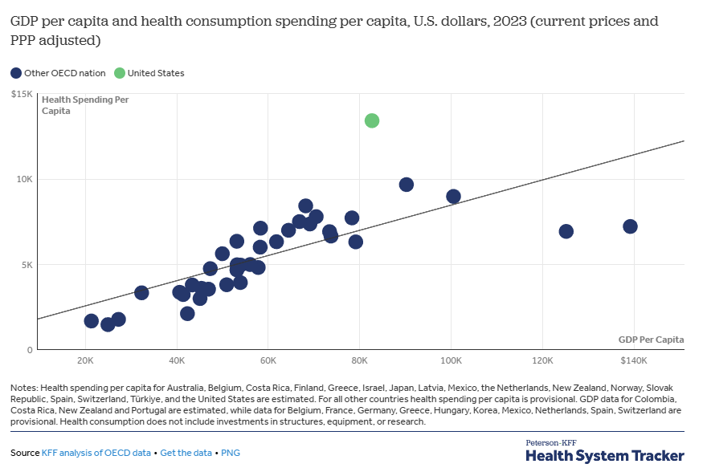
Why health economics?
US healthcare spending reached 5.3 Trillion USD (18% of GDP) in 2024 (cms.gov)
Per capita spending was over $13,000 per year in 2023
Notes:
This raises questions - is the healthcare system efficient?

Slide 16
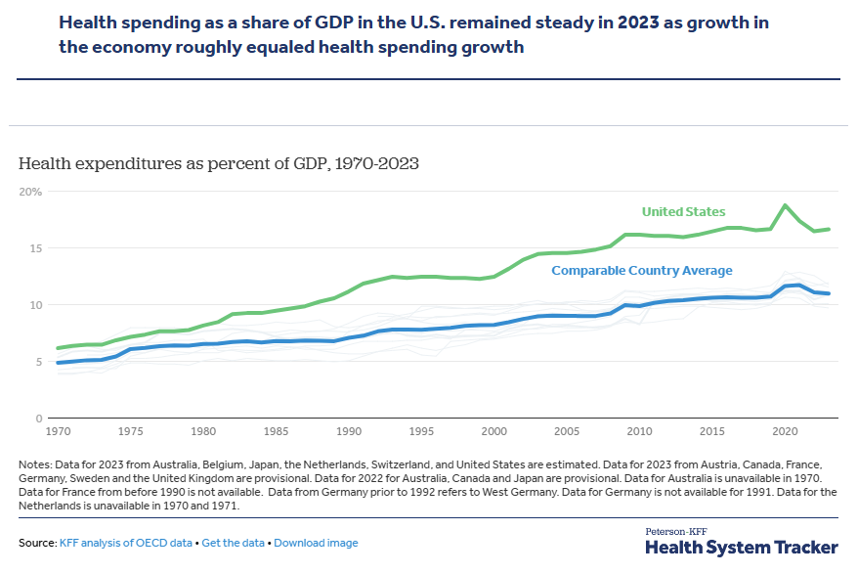
So, was it worth it?
Investments in early development of new drugs, devices, treatments
Higher health spending in the US than comparable countries (GDP-wise)
Notes:
This raises questions - is the healthcare system efficient?

Slide 17
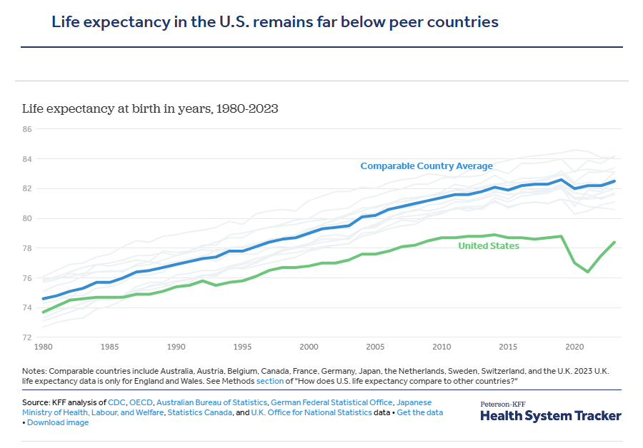
So, was it worth it?
Lower life expectancy, higher child mortality in the US vs. comparable country (~192 vs 71 per 100,000), higher maternal mortality

Slide 18
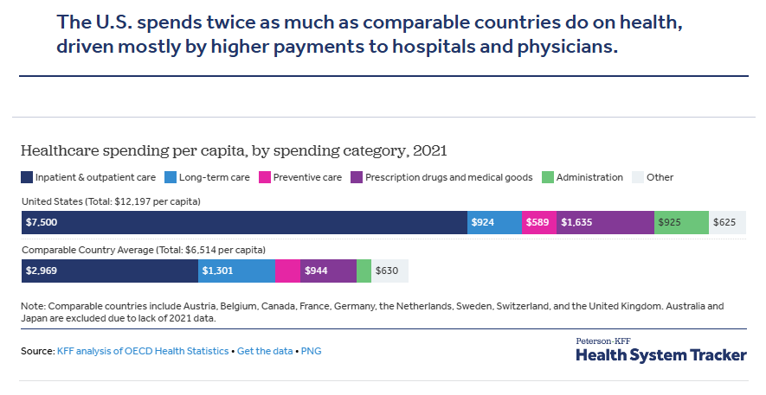
What’s the money spent on anyway?
Notes:
Patients in the U.S. have shorter average hospital stays and fewer physician visits per capita, while many hospital procedures have been shown to have higher prices in the U.S. This category also includes prescription drugs administered in inpatient and outpatient settings, which may lead to higher cost in countries, such as the U.S., where these drugs have higher prices.

Slide 19
Do not edit
How to change the design
Attendance Question: How much do Americans spend per capita on healthcare approximately?
Presenting with animations, GIFs or speaker notes? Enable our Chrome extension
Notes:
📣 This is Slido interaction slide, please don't delete it.
✅ Click on 'Present with Slido' and the poll will launch automatically when you get to this slide.

Slide 20
III. Opportunity cost & scarcity
Avastin: expensive cancer drug made by Genentech in the US, prescribed with chemotherapy for metastatic colorectal cancer.
Cost: 70,000 USD per 2-3 week course of treatment
Benefit: additional ~ 10 weeks in overall survival
Should medicare cover it?
Should taxpayers pay for it?
What are taxpayers not getting if they pay for this?
Where do we draw the line? What if the drug cost $200,000?
Notes:
Higher spending on healthcare means lower spending on other things (education, leisure, housing) → tradeoff

Slide 21
III. Opportunity cost & scarcity
Sovaldi: expensive drug made by Gilead in the US, prescribed for the cure of hepatitis C.
Cost: 90,000 USD per treatment
Benefit: cure, no need for continuous treatment
Should insurance cover it?
Should taxpayers pay for it?
What are taxpayers not getting if they pay for this?
Where do we draw the line? What if the drug cost $200,000?
Notes:
Higher spending on healthcare means lower spending on other things (education, leisure, housing) → tradeoff

Slide 22
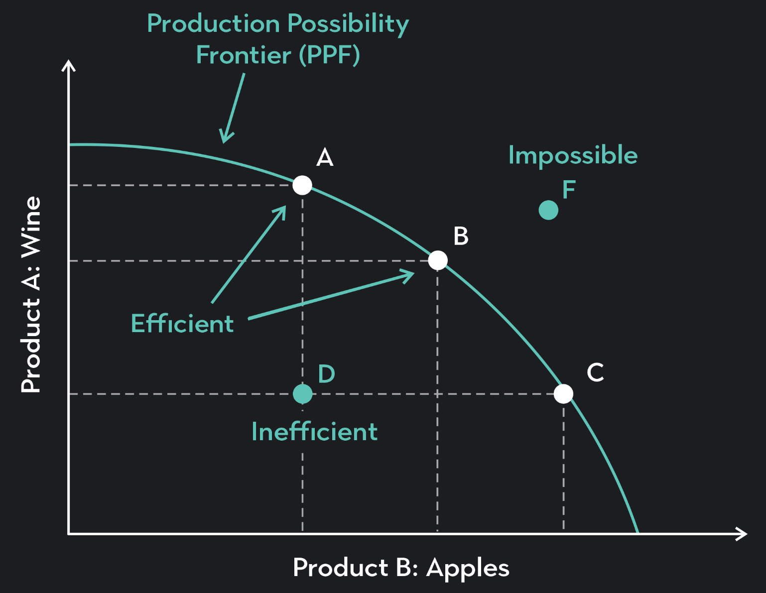
III. Opportunity cost & scarcity
Opportunity cost is the value of the best alternative that must be forgone when the action is taken.
Cost can be price
… but encompasses all value
“No free lunch”
PPF is a formalization of opportunity cost.
Notes:
Higher spending on healthcare means lower spending on other things (education, leisure, housing) → tradeoff

Slide 23
III. Opportunity cost & scarcity
Talk to your neighbor: What was the opportunity cost of your degree?

Slide 24
IV. Thinking on the margin
“What does the additional increase in consumption mean for the cost”?
→ Will your 4th friend fit in the uber?
→ 3rd kid → 2 taxi vs. 1 taxi family
→ extra 30 min of studying vs. going to sleep
Notes:
→ 1st bite of dessert vs. last bite of dessert
→ average pollution vs. marginal pollution of flying

Slide 25
V. Rational thinking
We assume that individuals abide by the following principles when making decisions:
Completeness: there is always a preference
Transitivity: A>B, B>C → A>C
Responding to Incentives: allocation of resources follows value maximization
No Requirement of Perfect Information
Room for Mistakes, but mistakes don’t dominate behavior

Slide 26
Closing thoughts: not all economists see things the same way
They may have disagreements on underlying values
They may have disagreements on assumptions
They may have disagreements on interpretation of findings and scientific judgments
→ They use the same frameworks, but may not get to the same conclusions
The goal of this class is to teach you how to think rigorously about health using a microeconomic framework.

Slide 27
Next week
The demand for health care
Readings will be uploaded to canvas after class today
Problem set 1 will be assigned next week

Slide 29
Why so expensive?
IOM named 6 main causes of the high healthcare expenditures in the US:
Inefficiencies in care delivery
Care coordination failures
Fraud
Administrative costs (>250B)
Low value care
High prices
Notes:
Patients in the U.S. have shorter average hospital stays and fewer physician visits per capita, while many hospital procedures have been shown to have higher prices in the U.S. This category also includes prescription drugs administered in inpatient and outpatient settings, which may lead to higher cost in countries, such as the U.S., where these drugs have higher prices.

Slide 30
Expenditure or Revenue?
It depends on the POV:
From payer, individual, societal perspective: Expenditure = Price * Quantity
From a provider perspective: Revenue = Price * Quantity
Varying incentives among stakeholders can lead to inefficiencies

